Slide 1
GARMENTS INVENTORY MANAGEMENT SYSTEM

Slide 2
GRAPHICAL USER INTERFACE

Slide 3
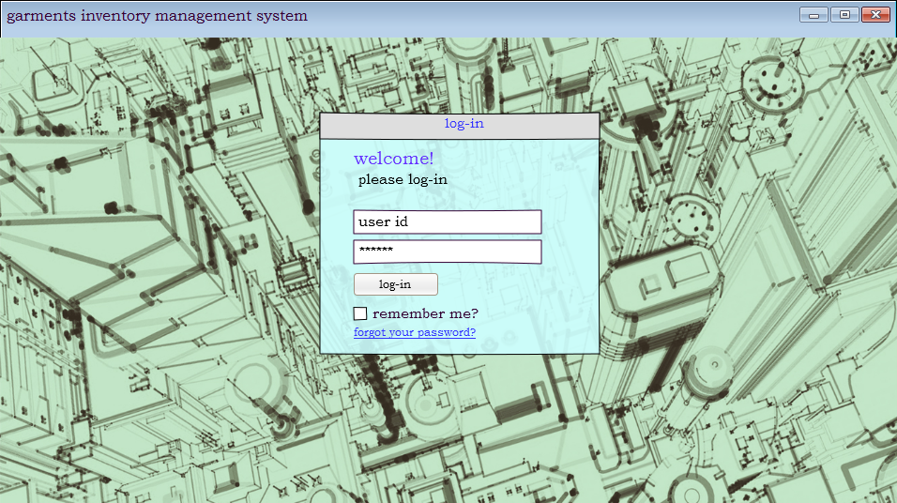
welcome screen

Slide 4
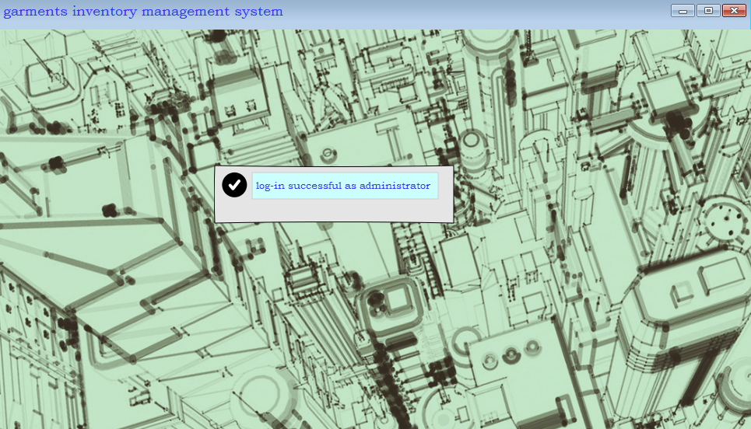
if Log-in successful

Slide 5
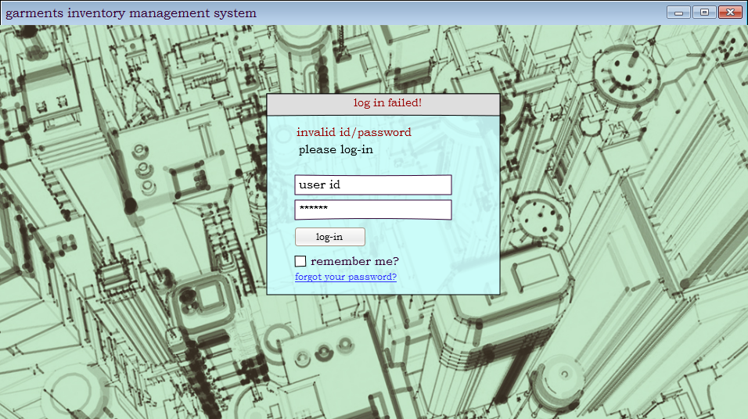
if Log-in not successful

Slide 6
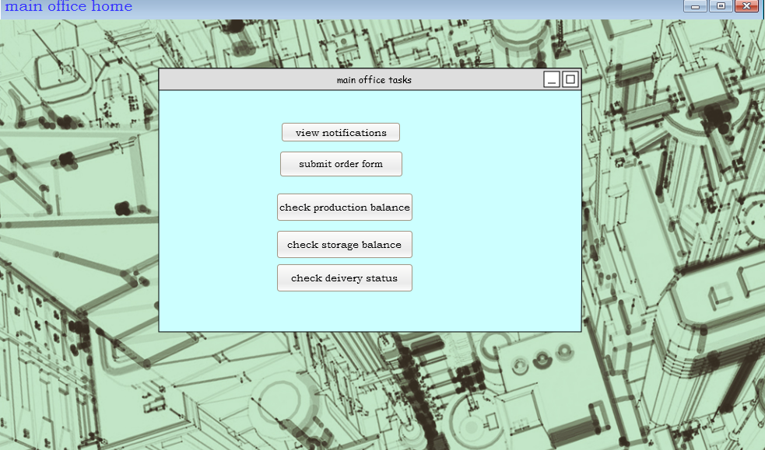
Main office home

Slide 7
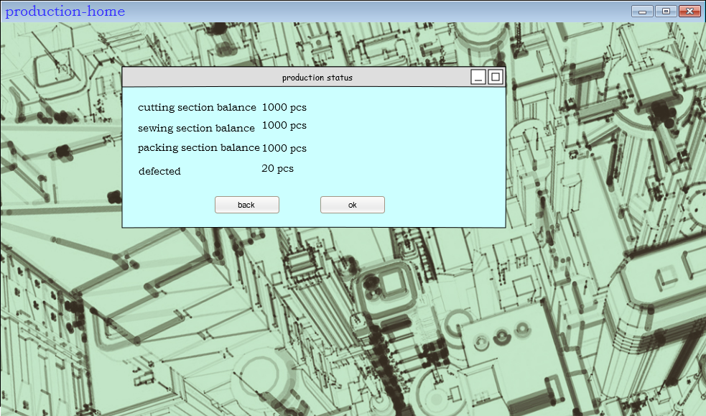
check production balance

Slide 8
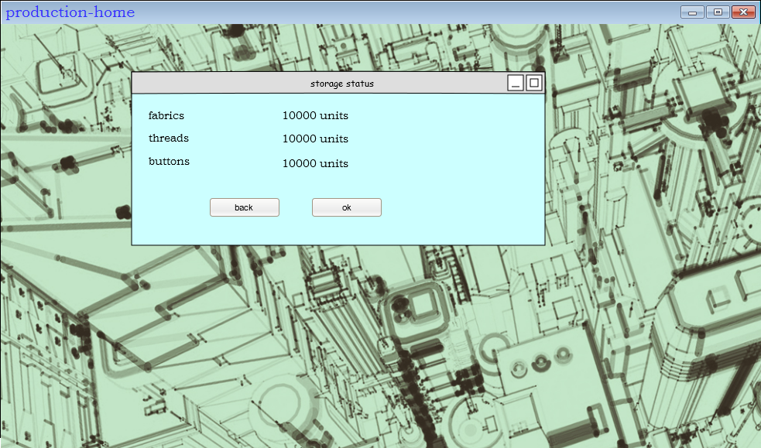
Check storage balance

Slide 9
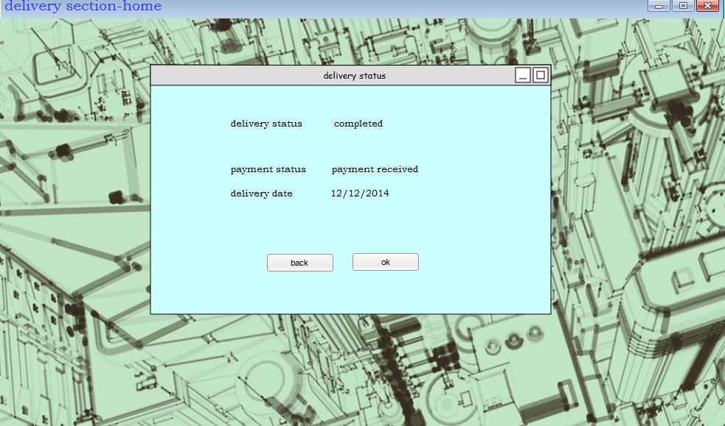
Check delivery status

Slide 10
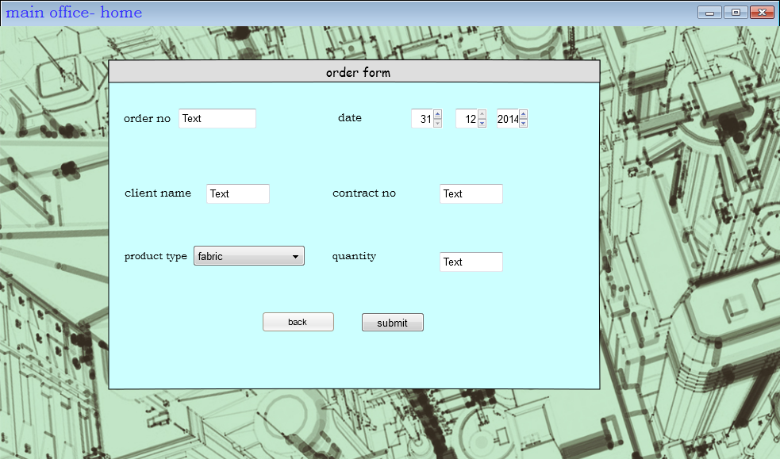
submit order form

Slide 11
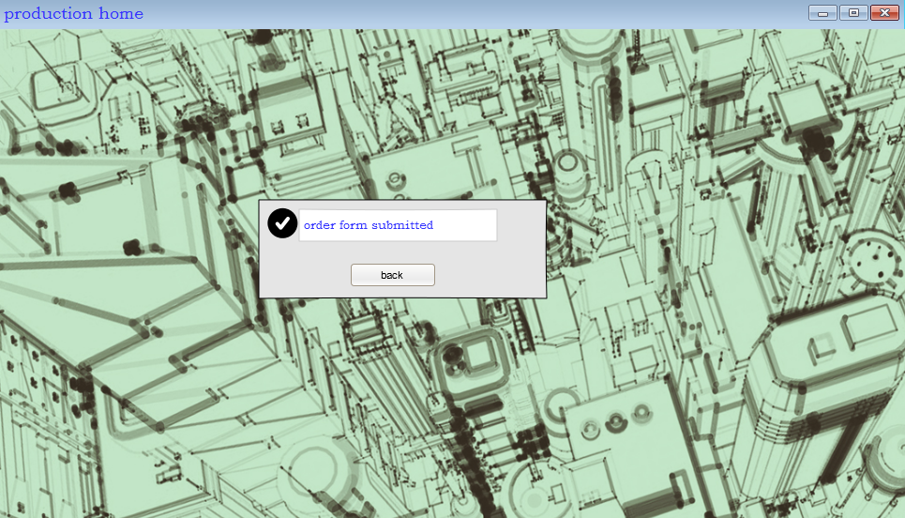
order form submitted successfully

Slide 12
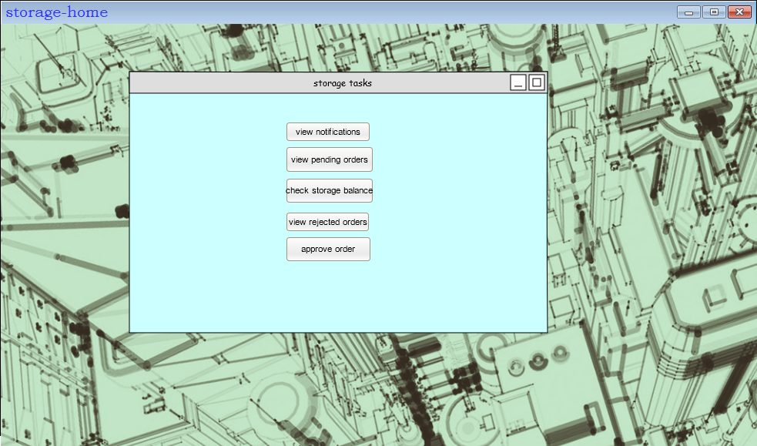
storage menu

Slide 13
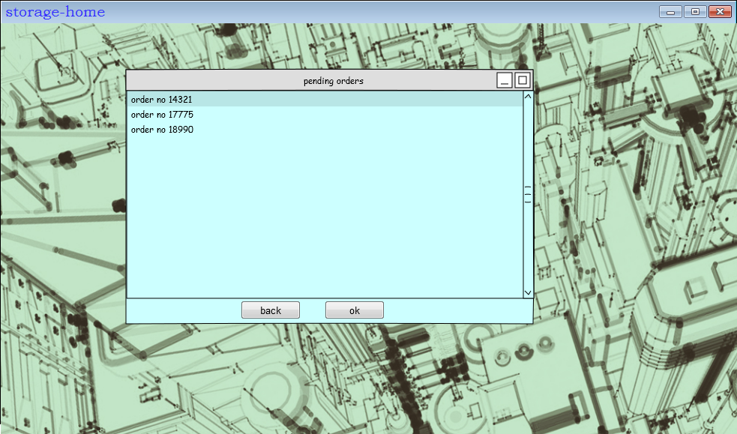
view pending orders

Slide 14
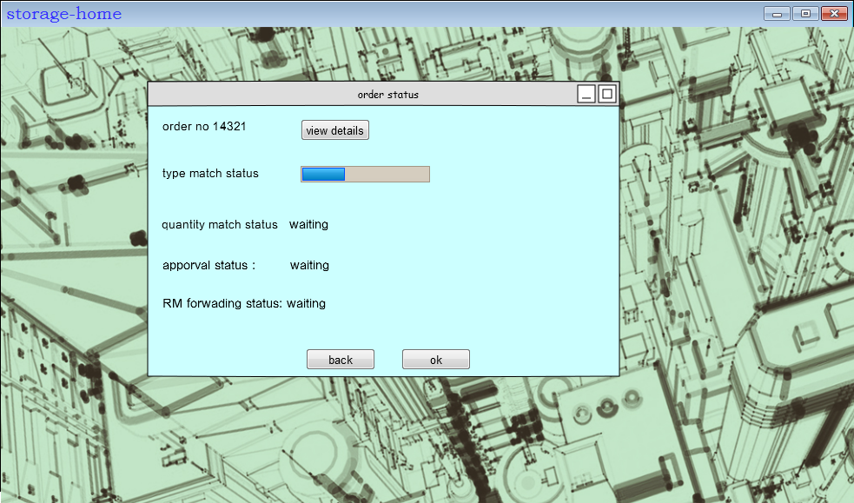
after selecting a form

Slide 15
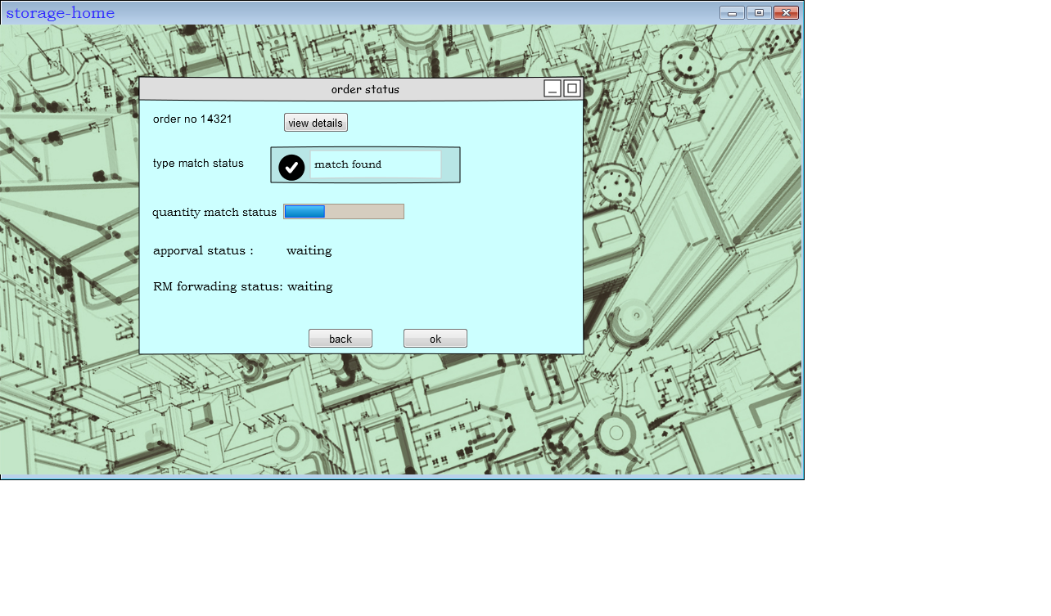
match type successful

Slide 16
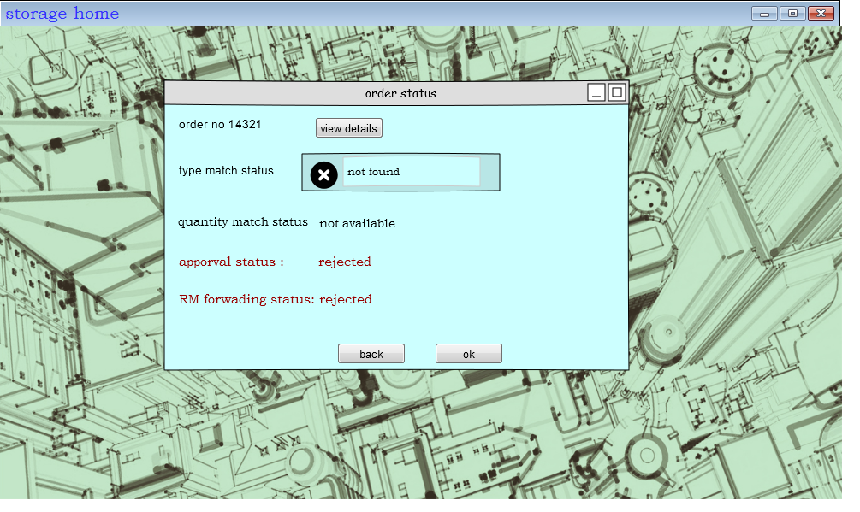
match type not successful

Slide 17
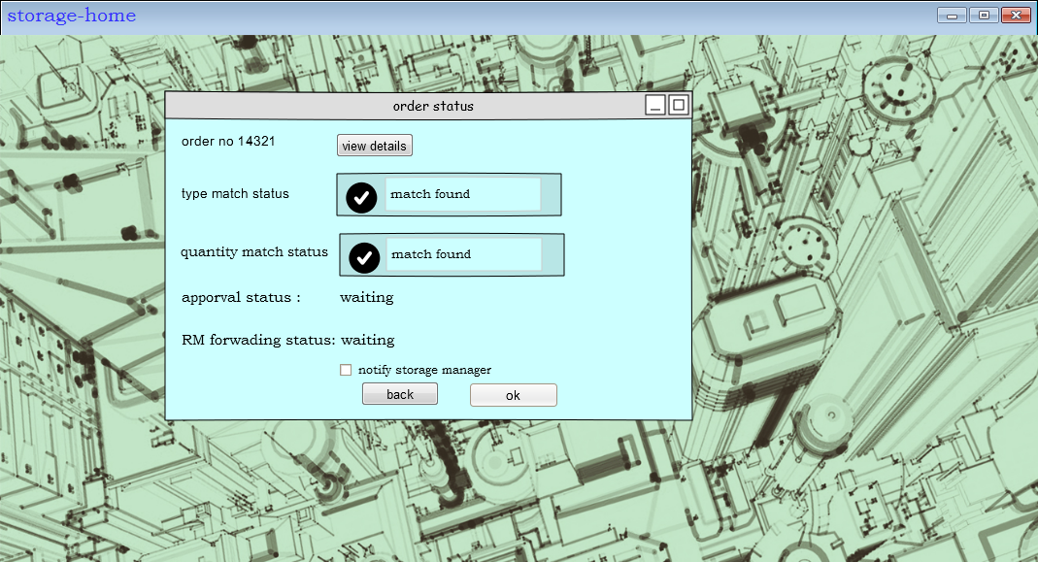
match quantity successful

Slide 18
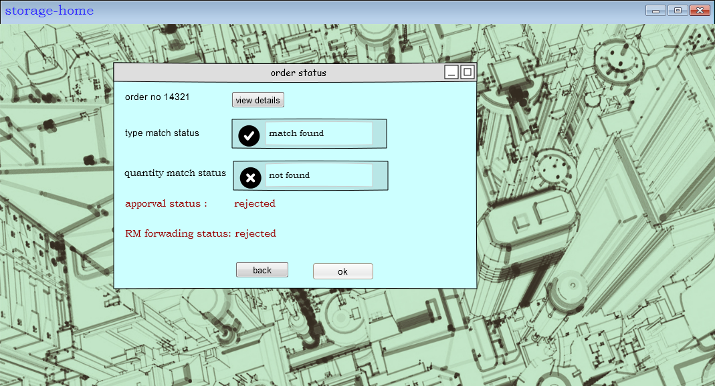
Match quantity not successful

Slide 19
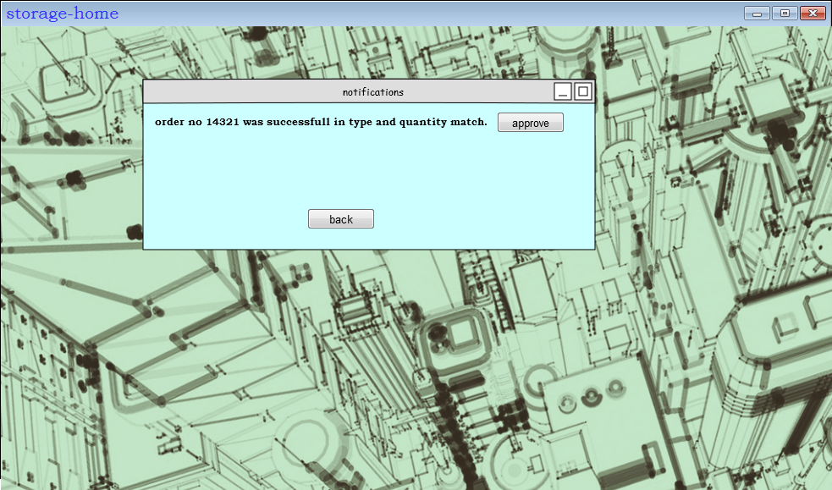
view notifications

Slide 20
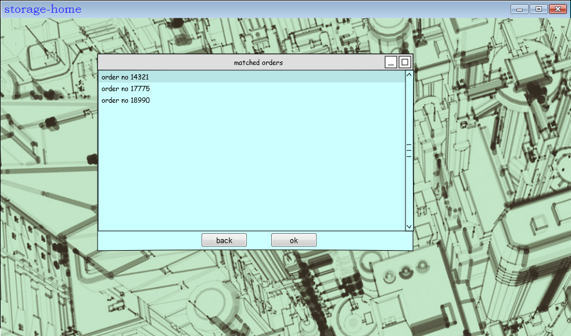
approve order

Slide 21
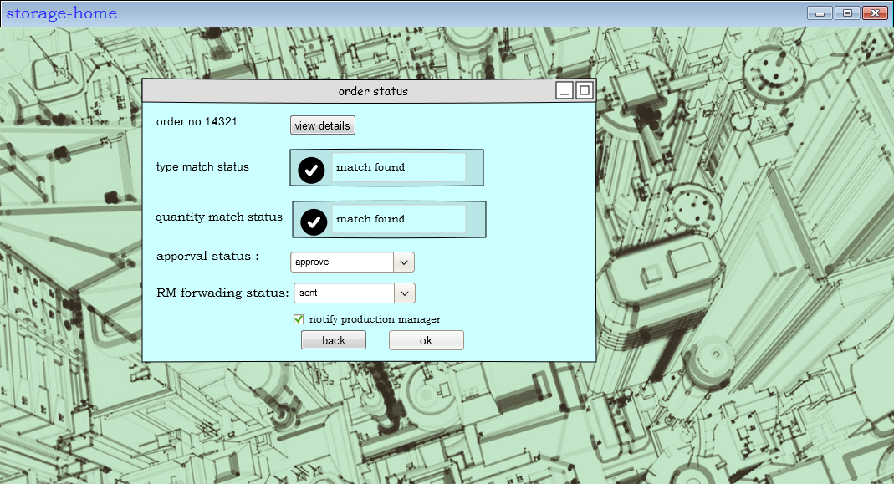
After selecting a form

Slide 22
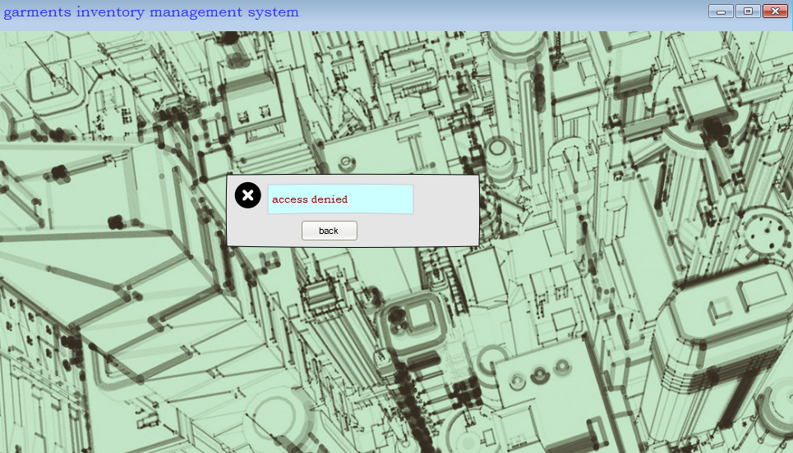
If user is not authorized

Slide 23
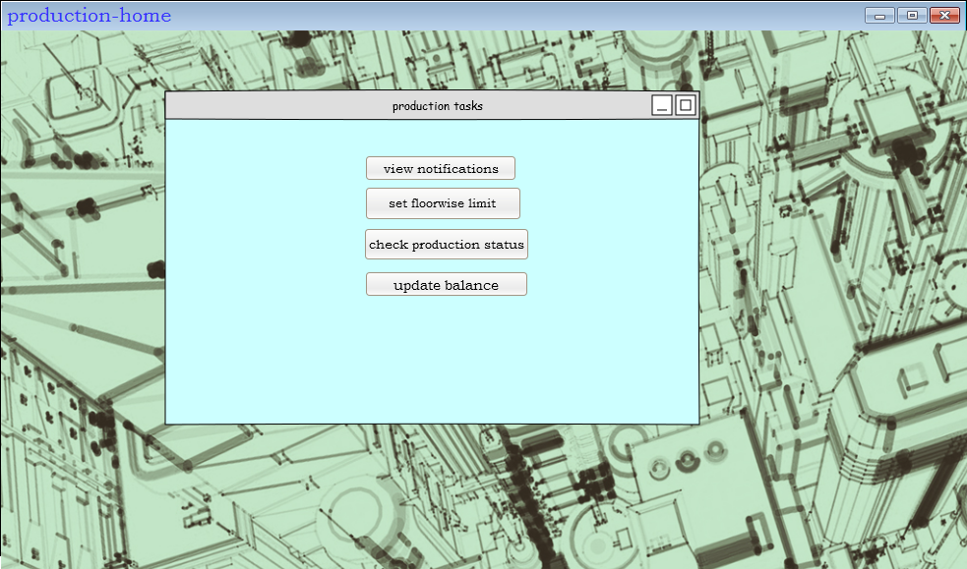
Production home

Slide 24
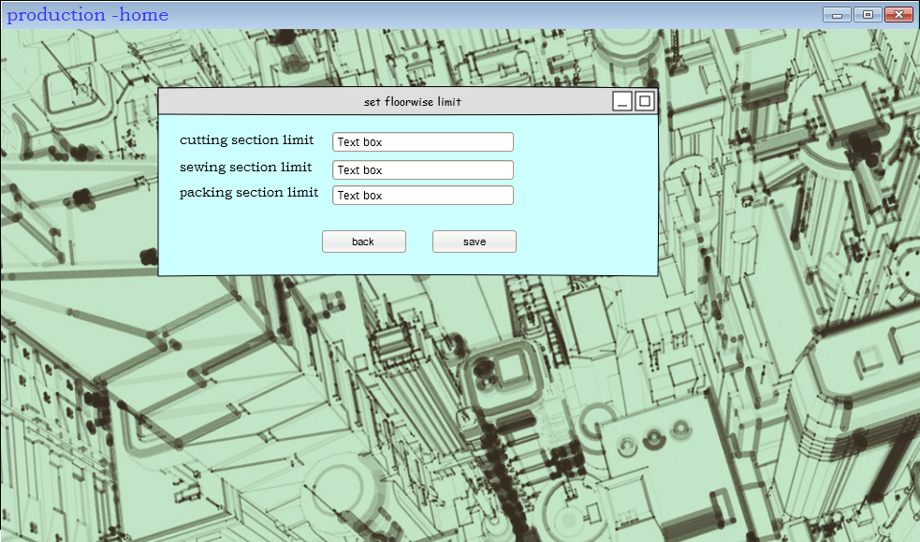
Set floor wise limit

Slide 25

check production status

Slide 26
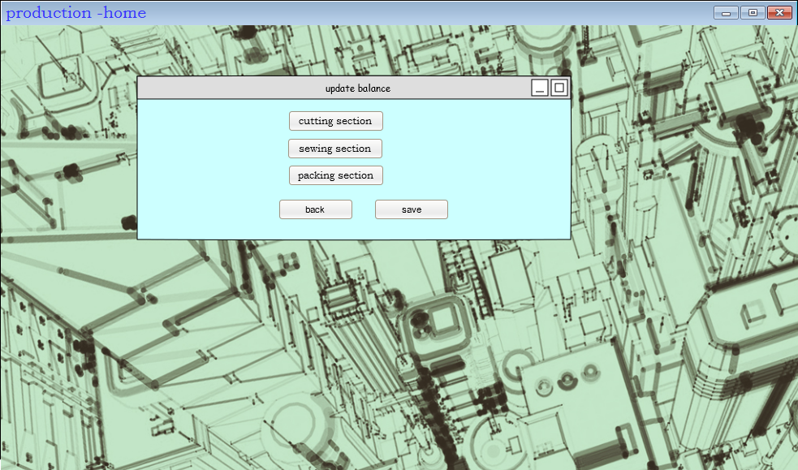
update production status

Slide 27
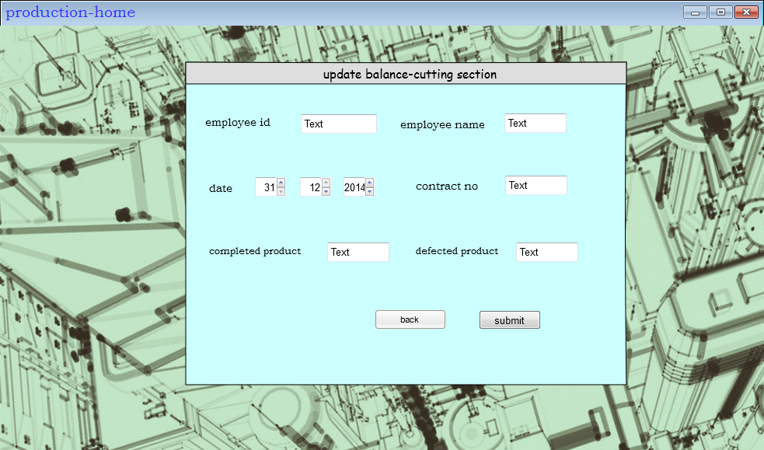
Updating the cutting section balance

Slide 28

Updating the sewing section balance

Slide 29
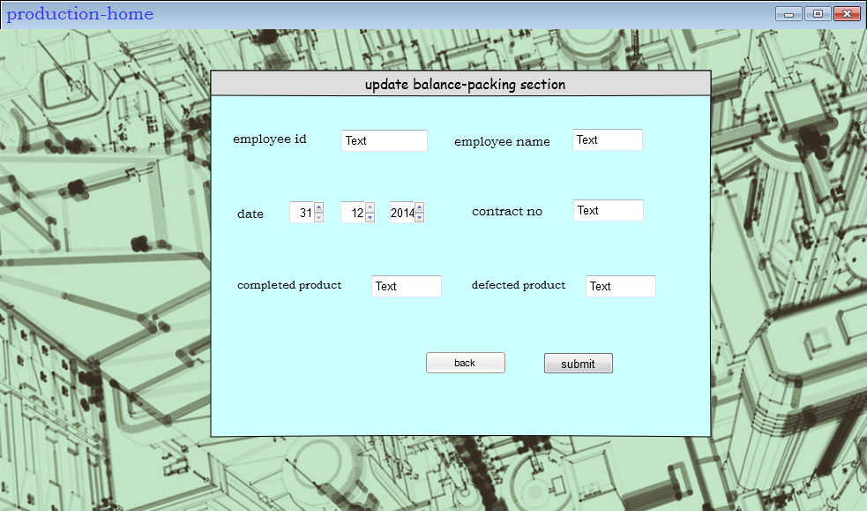
Updating the packing section balance

Slide 30

Balance updated successfully:

Slide 31

delivery section menu

Slide 32
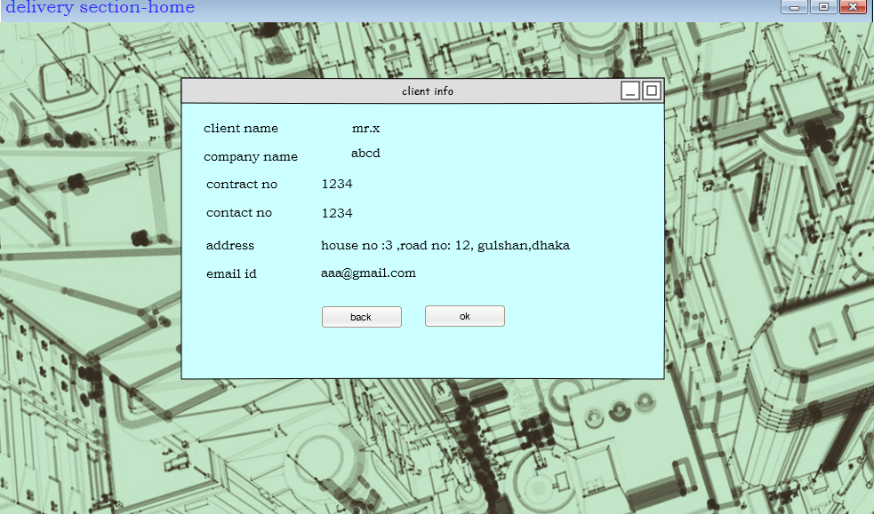
client info

Slide 33
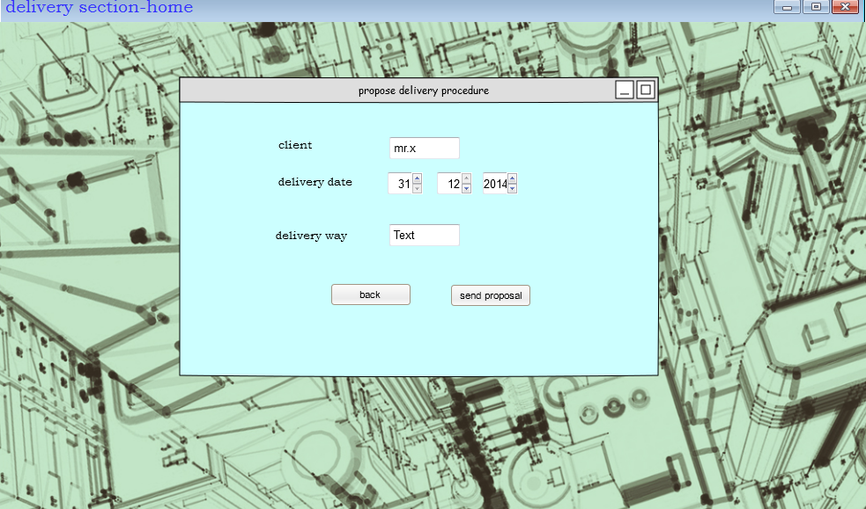
propose delivery process

Slide 34
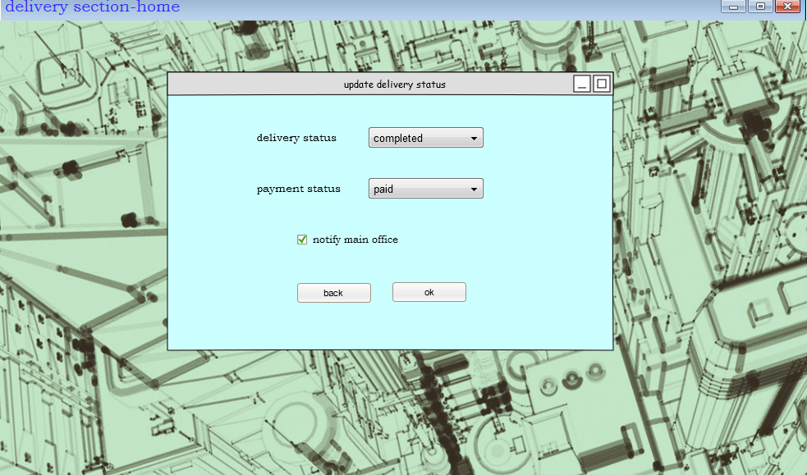
update delivery status

Slide 35
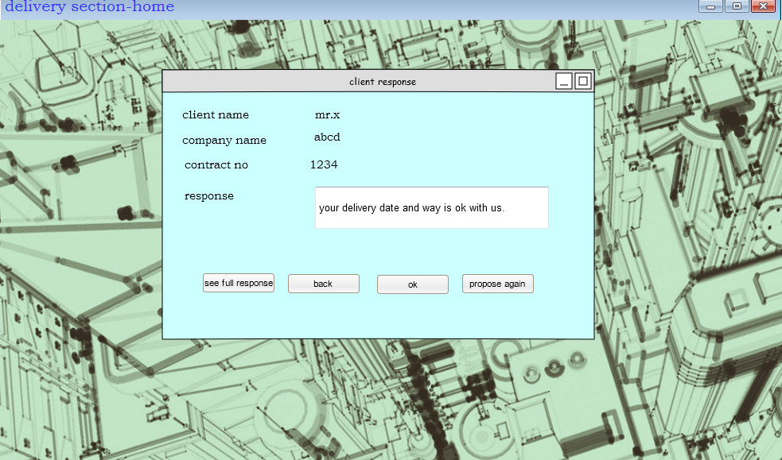
get client response

Slide 36
Check delivery status

